Slide 1
PROJECT 4B spaces of historic GEORGE TOWN

Slide 2
Group members:
Sim Dan Zhou 103763
- Amelia Liew Yenchi 103649
- Lam Xin Yee 103683
- Lim Lai Sim 103692
-Ng Pui Yeen 103724

Slide 3
INTRODUCTION:
We visited George Town on 13th August 2009 to do our research on the spaces of the World Heritage Site. After consideration, we have decided our theme to be RELIGIOUS. We want to explore about the spaces and forms of historical buildings of different religions.
The three places we chose were Lebuh Acheh Malay Mosque, Khoo Kongsi and Mahamariamman Temple. The main reason we chose these places were because they are the origin of religion of major races in Malaysia.

Slide 4
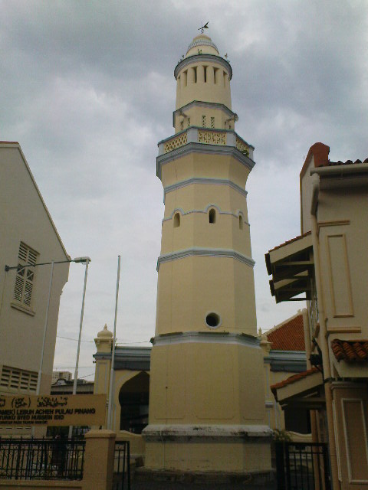
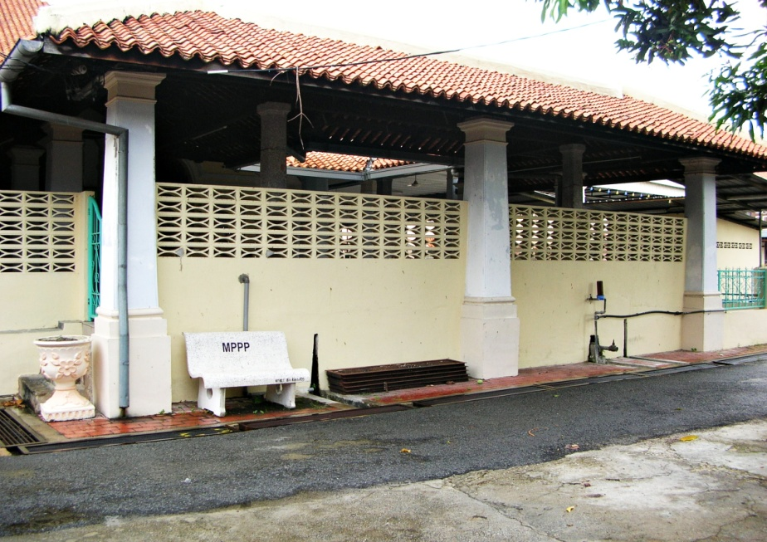
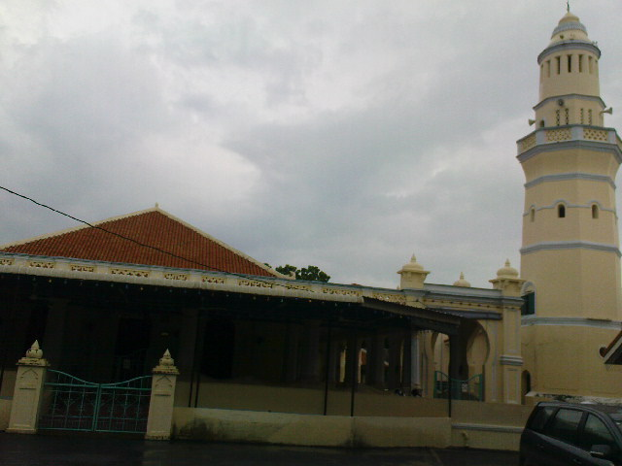
Lebuh Acheh Malay Mosque
The approximate size of this mosque is 2000 square metres.
The main function of this mosque serves for praying purposes where the Muslims worship Allah. Besides that, this mosque is also used for giving spiritual talks to motivate people.
Lebuh Acheh was founded in 1808 by the wealthy Achehnese Tengku Syed Hussain bin Abdul Rahman.

Slide 5
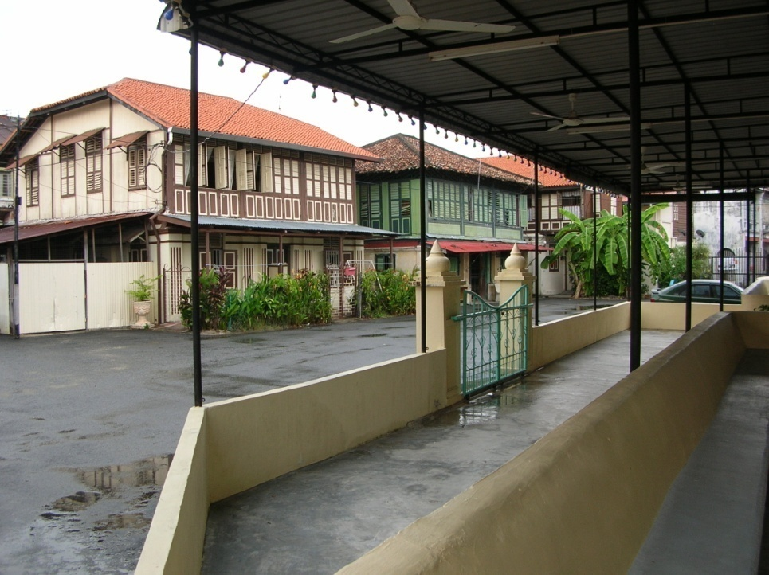
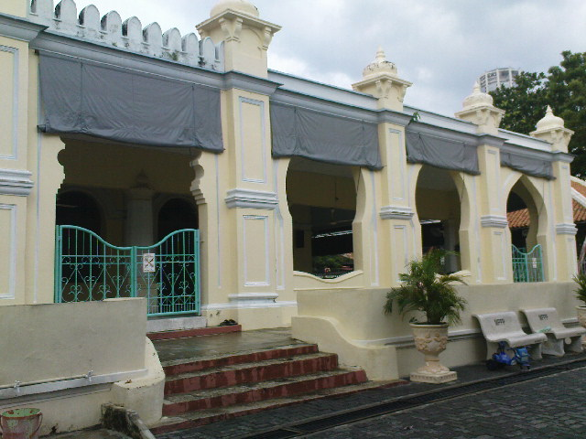
Lebuh Acheh Malay Mosque is located at the southern end of George Town. There are many historical shop lots in front of the mosque. Apart from that, there are also malay traditional wooden houses surrounding the mosque.
Based on our observation, we noticed a few modifications such as new canvas which provides shade to protect from sunlight and stone chairs built by MPPP for people to rest.

Slide 6
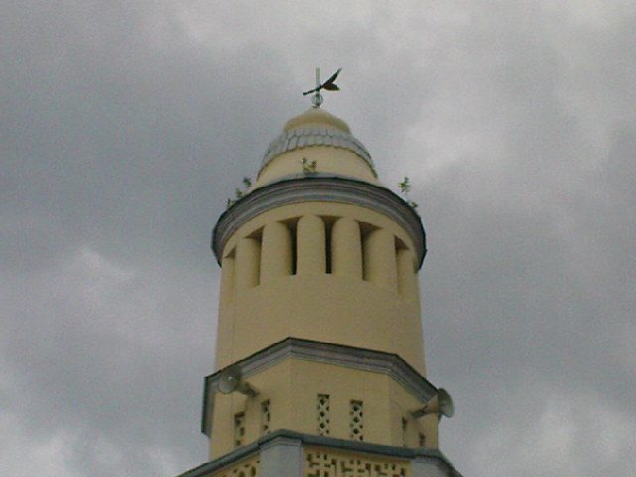
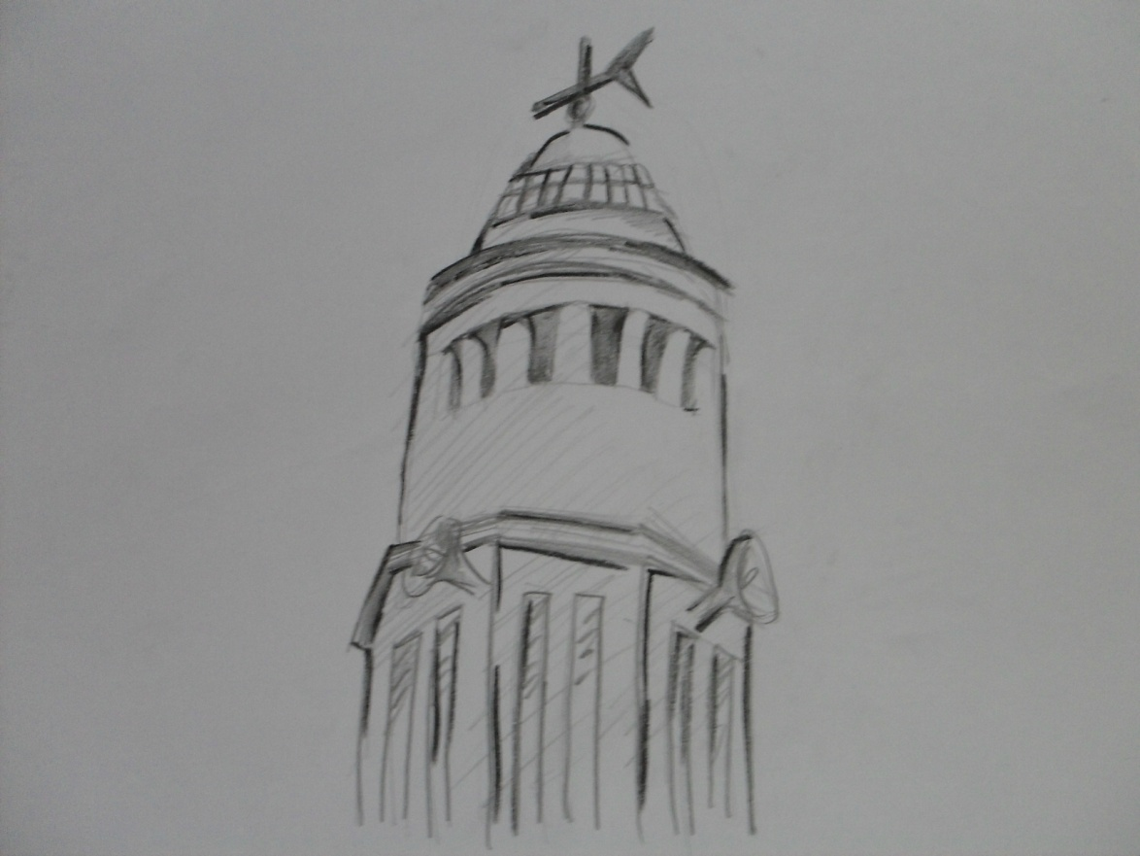
The octad minaret shows the various communities of Penang such as the Chinese, Anglo-Indian and Achehnese. The attractive feature of this minaret includes the compass on the top that has the analogy of giving people the real direction in life.

Slide 7
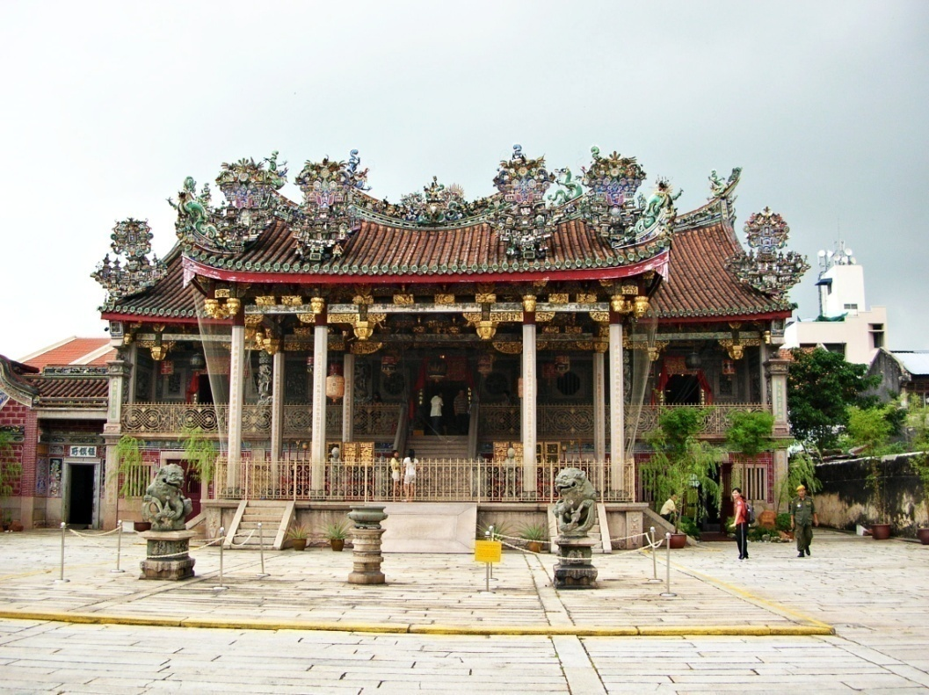
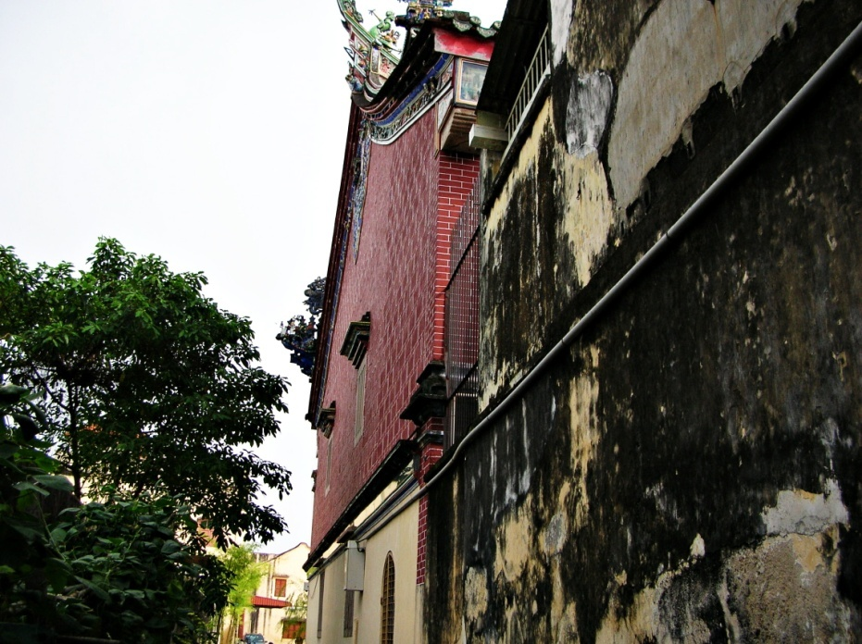
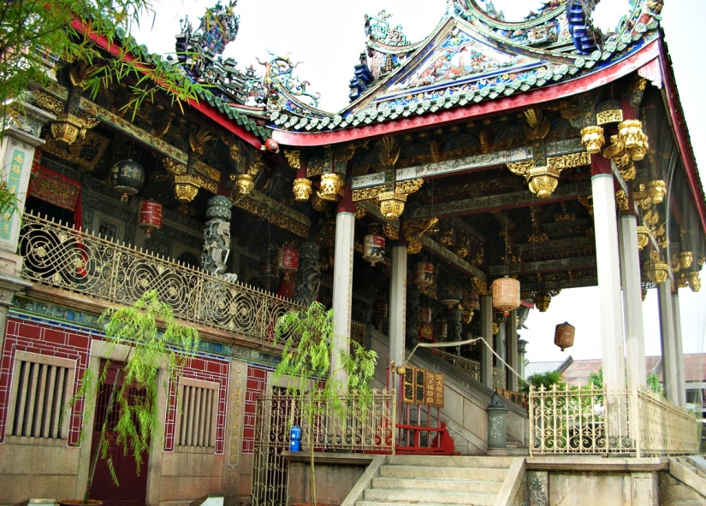
The size of the temple including the residential area of the Khoo Clan is about 6000 square metres.
The functions of the temple are thanksgiving to Ancestors with Dinner for graduates and clansmen who are awarded with title. Besides that, people use this temple to celebrate Chinese Festival. The temple also provide burial plot or columbarium to their clansmen and wives bury or to place their ashes.
The temple was firstly built on 1851 and it was rebuilt from 1901 to 1906 after the big burnt down on 1894.
Khoo Kongsi

Slide 8
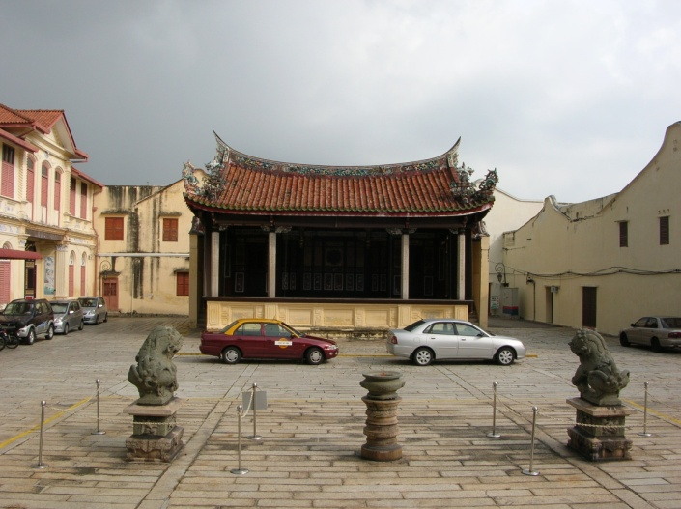
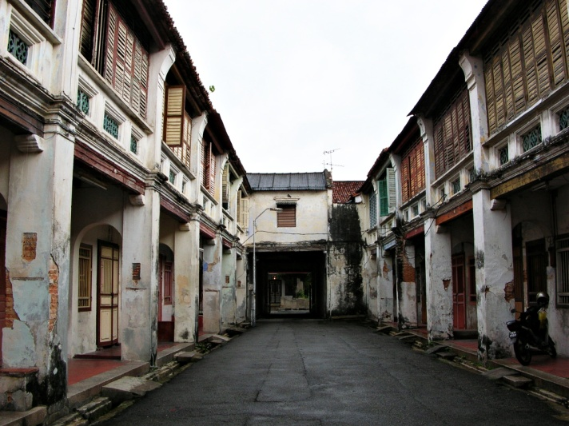
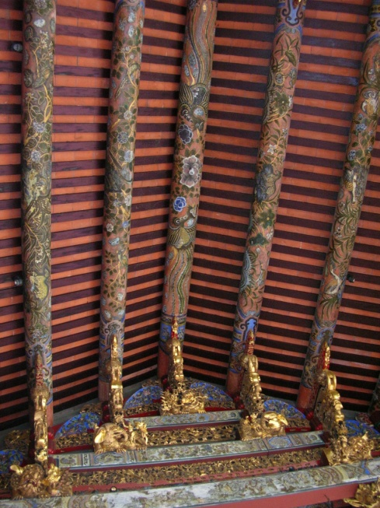
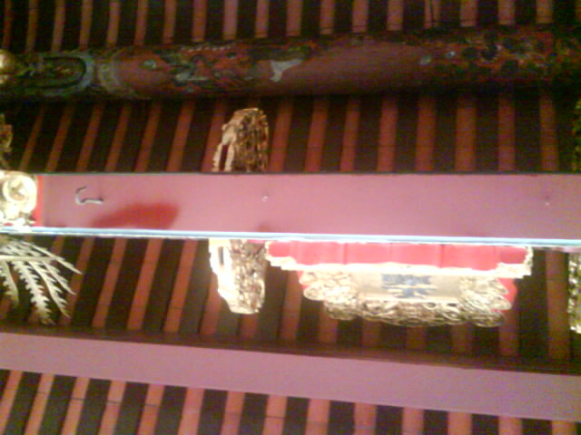
The temple is situated in Cannon Square in the middle of the oldest part of George Town and its pivotal building, Leong San Tong is hidden among the crowded terrace houses and shop houses of the clan’s residential area. In front of the temple is the opera theatre where short moral stories or experiences are to be recorded to let people understand the message. The clan’s residential area surrounding the Leong San Tong in the other hand are rented out to gain profit.
There is an constructing error in this temple where two of the beams shown in the picture didn’t put on the golden cravings after a renovation of conflagration.

Slide 9
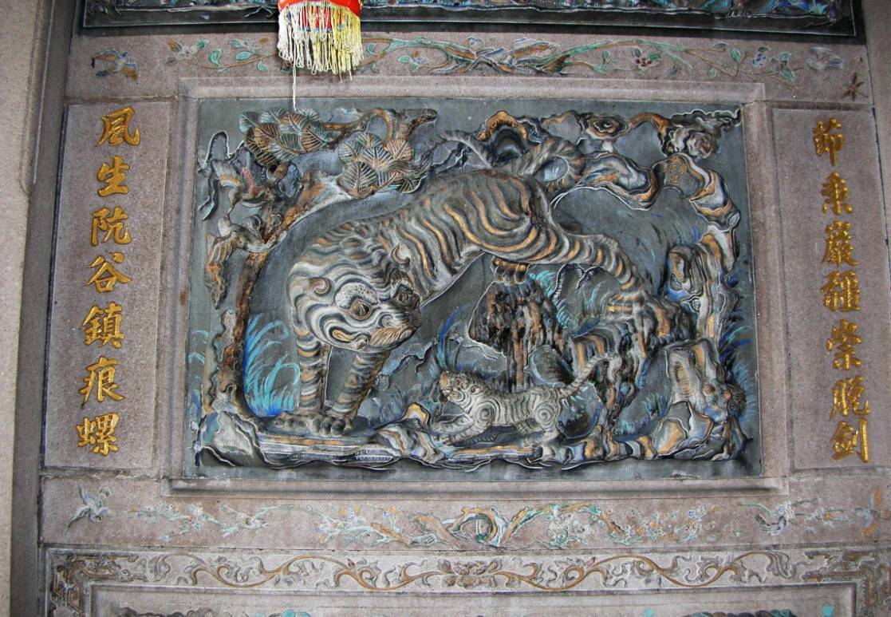
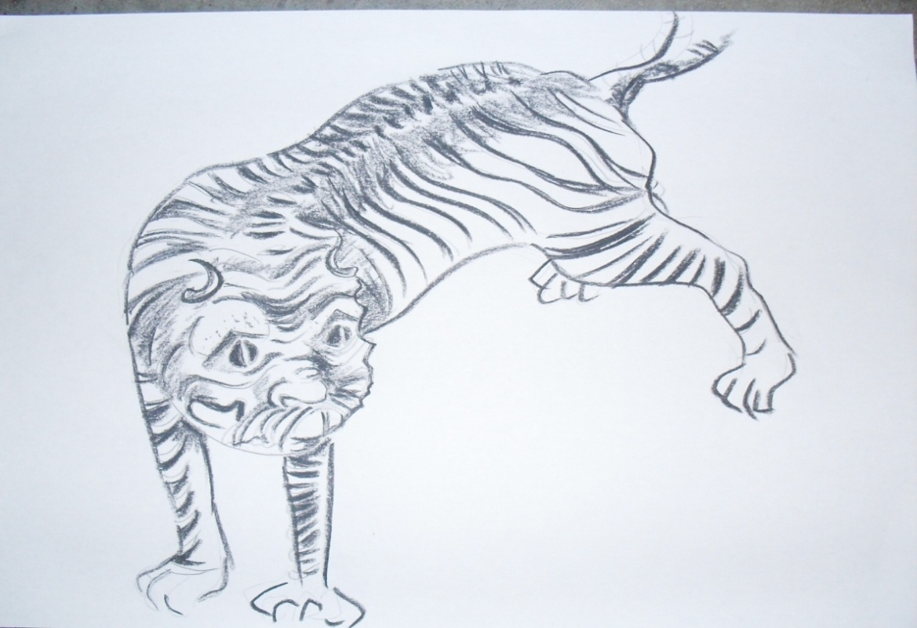
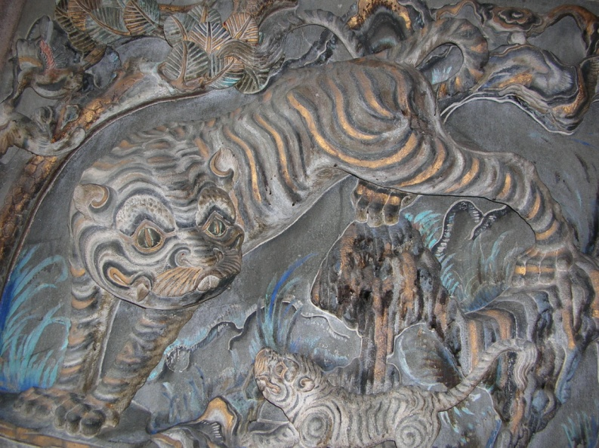
The ornament in this temple which is the Tiger symbolizes the beginning of everything.

Slide 10
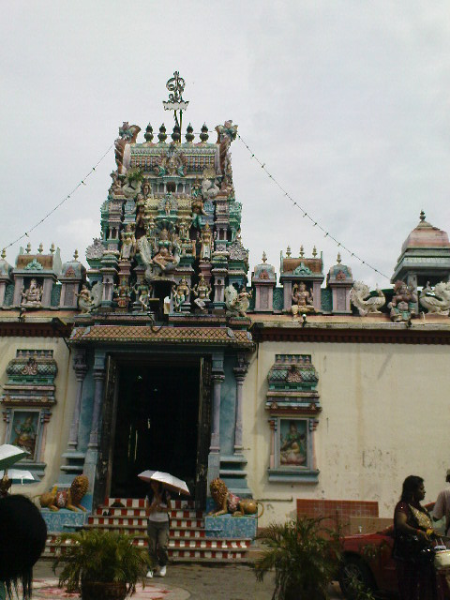
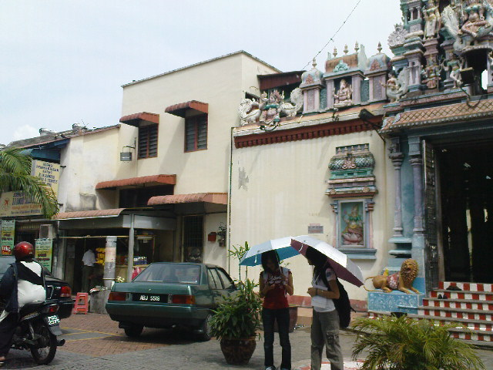
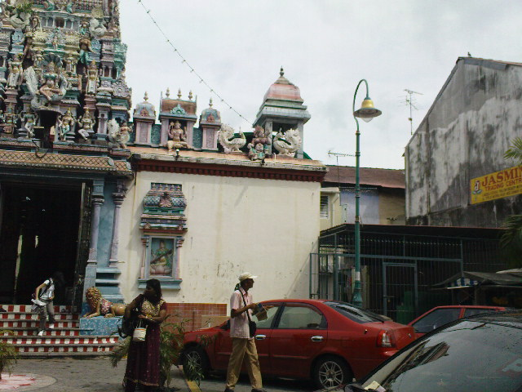
Mahamariamman Temple
This temple was founded in 1833
It is renovated and consecuted on 14 December 1870
Previous consecretions are on 1933, 1958 and the latest is 3rd September 1998
The approximate size of this temple is 1800 square meter
The functions of this temple are for praying, cheering, Festival and marriage celebration

Slide 11
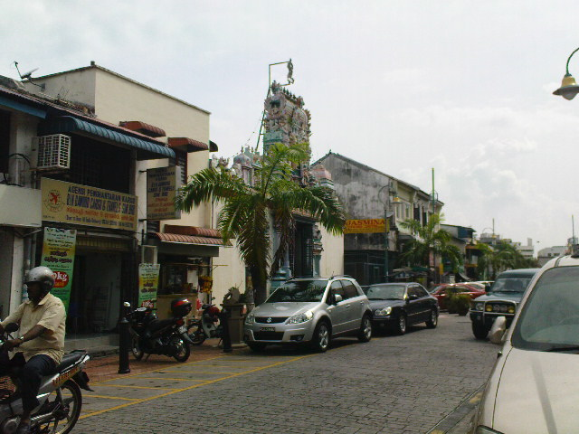
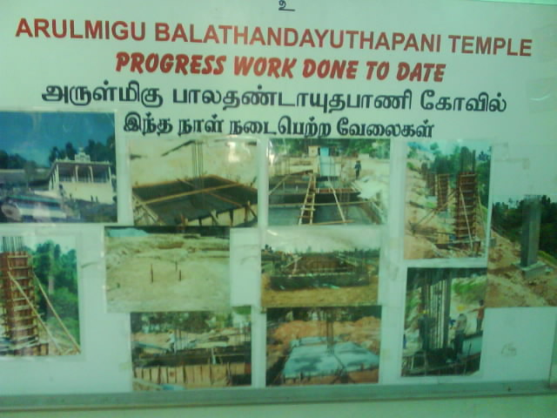
The festival celebrates in this temple includes the two weeks Navaratari which is an important festival for the Hindu.

Slide 12
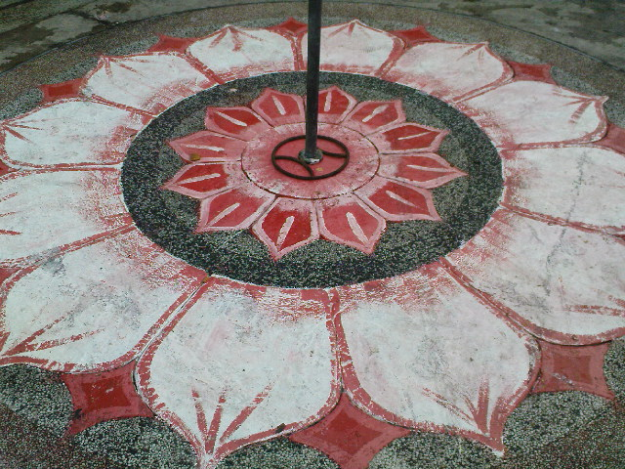
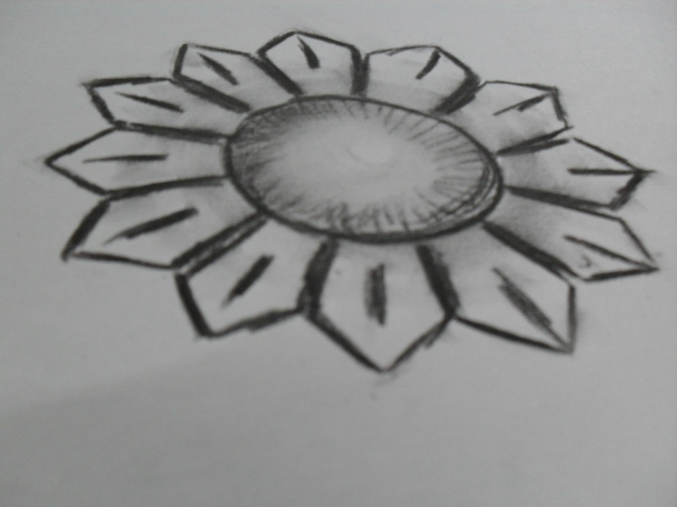
The festive artwork in front of the temple is one of the main tourist attractions.

Slide 13
After a one day trip in Georgetown, we learned a lot from the heritages and the residents nearby. The intricate design of heritages were built long ago without the advent of cutting edge technology which made us admired their intelligence. We hope that these heritages will persevere until the future.
-The End-

